Slide 1

AI-Based Exoplanet Detection Using NASA Kepler and TESS Data
A Fusion of Astronomy and Machine Learning for Automated Discovery
Presented by: Abhinav V R
Beneeta Justice
Sreepadh I S
| Date: October 5, 2025

Slide 2



The Frontier of Exoplanet Discovery
What are Exoplanets?
NASA Mission Data
The Manual Challenge
Planets orbiting stars other than the Sun. Their discovery is crucial for understanding planetary formation and the prevalence of life.
Missions like Kepler and TESS generate massive datasets—analyzing fluctuations in stellar brightness (light curves) to find transit events.
Current manual analysis of millions of light curves is time-consuming, prone to human error, and struggles to keep pace with data volume.

Slide 3




Project Objectives: Automating Discovery
Enhance Accuracy
Improve Speed and Scale
Achieve high predictive accuracy to distinguish true transit signals from astrophysical false positives and instrumental noise.
Automated Detection
Significantly reduce the time required for candidate vetting, enabling analysis of the full TESS and Kepler archives efficiently.
Develop and implement machine learning models (both traditional ML and Deep Learning) to automatically identify exoplanet candidates from light curves.

Slide 4


Dataset Overview: Kepler & TESS Archives
Our project leverages two primary datasets from NASA's planet-hunting missions. These raw observations are the foundation for our AI models.
Kepler Data
TESS Data
Legacy Focus: Targeted deep-field survey, focused on a single region for four years.
All-Sky Survey: Observes 85% of the sky in 26 sectors, focusing on bright, nearby stars.
Data Type: High-precision photometric measurements of over 150,000 stars.
Data Challenge: Shorter observation periods often result in fewer observed transits per star.
Sample Size: ~9,000 confirmed/candidate transit events analyzed.
Feature Space: Includes derived features like period, duration, depth, and signal-to-noise ratio (SNR).

Slide 5
Machine Learning Approach: Random Forest Classifier
The initial phase employed traditional ML on extracted, tabular features, providing a robust baseline for comparison with Deep Learning.
Feature Selection
Data Preprocessing
Model Implementation
12 key metrics derived from the light curve (e.g., period, transit duration, V-shape of the light curve).
Handling class imbalance (many more non-exoplanets than confirmed planets) using SMOTE oversampling.
Random Forest was chosen for its high efficiency, interpretability, and ability to handle non-linear relationships in the tabular data.
A focus on features that quantify transit morphology and stellar properties.
Standardization and normalization of continuous features.
Target: Binary classification (Exoplanet vs. Non-Exoplanet).

Slide 6






Deep Learning Approach: Convolutional Neural Networks (CNN)
To leverage the raw structure of the light curve time series data, we implemented a 1D Convolutional Neural Network (CNN).
Processing Raw Light Curves
CNN Architecture
We used the Lightkurve library to programmatically access and process raw Kepler/TESS time series data.
Input
Conv Block 2
200 time-series data points
Conv1D + ReLU then MaxPool
Detrending and flattening to remove long-term stellar variability.
Phase folding the light curves around the transit period to align the signals.
Binning data points to a fixed-length vector (e.g., 200 points) for consistent CNN input.
Conv Block 1
Conv Block 3
Conv1D + ReLU then MaxPool
Conv1D + ReLU then MaxPool
The CNN directly learns spatial features (patterns) within the light curve, eliminating the need for manual feature engineering.

Slide 7
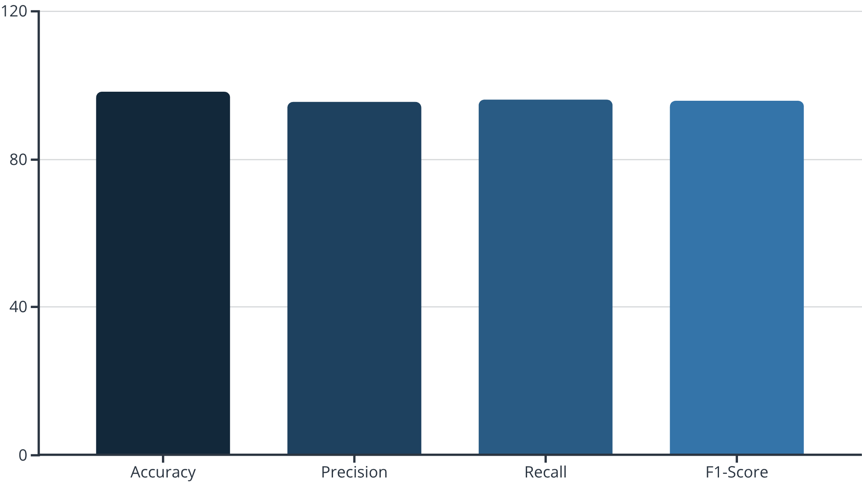

Results and Model Performance
Key Performance Metrics (CNN Model)
Visualizing Feature Importance (RF)
The CNN model achieved strong generalization capabilities, crucial for identifying new, unconfirmed candidates.
Top Features: Transit Depth, Period, and Signal-to-Noise Ratio (SNR).
The Random Forest confirmed that the depth and clarity of the transit signal are the strongest predictors.
Example Prediction: The model successfully flagged KIC 8462852 (Boyajian's Star) transit data as an anomalous signal due to its non-standard light curve features.

